Slide 1
Multithreading

Slide 2

Learning Objectives Exception
Introduction
Defining, Instantiating, and Starting threads
Extending Thread class implementing Runnable interface
Main thread
Thread Priorities
Thread names
Sleep(), Join()
Synchronization
Inter thread communication

Slide 3
Introduction
Multithreading in java is a process of executing multiple threads simultaneously. Thread is basically a lightweight sub-process, a smallest unit of processing. Multiprocessing and multithreading, both are used to achieve multitasking.
Advantages
1) It doesn't block the user because threads are independent and you can perform multiple operations at same time.
2) You can perform many operations together so it saves time.
3) Threads are independent so it doesn't affect other threads if exception occur in a single thread.

Slide 4
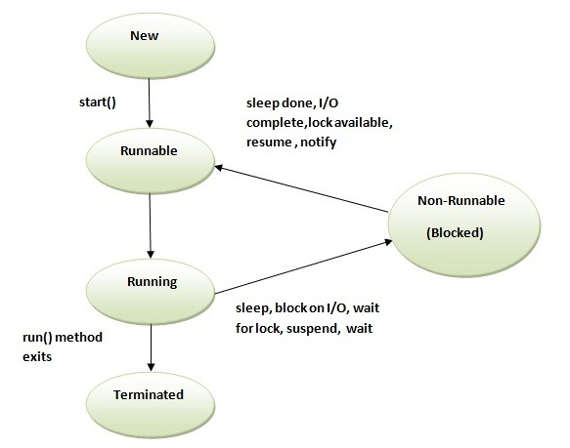
Life Cycle of Thread

Slide 5
Create Thread
There are two ways to create a thread:
By extending Thread class
By implementing Runnable interface.
Thread Class
Thread class provide constructors and methods to create and perform operations on a thread. Thread class extends Object class and implements Runnable interface.

Slide 6
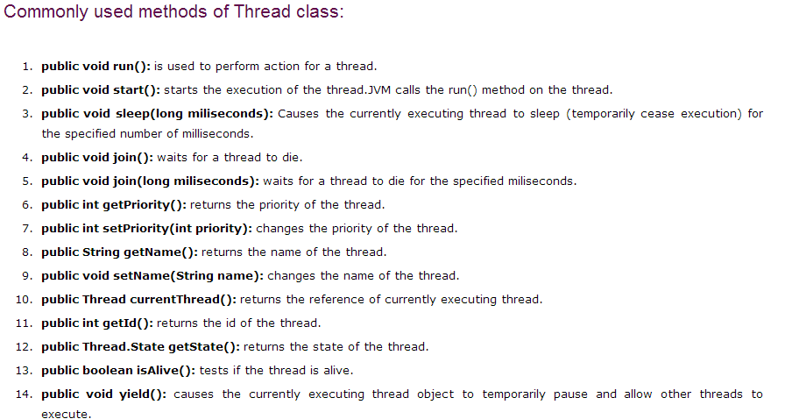
Thread Class Method

Slide 7
Runnable Interface
The Runnable interface should be implemented by any class whose instances are intended to be executed by a thread.
Runnable interface have only one method named run().
public void run(): is used to perform action for a thread.
Starting a thread
start() method of Thread class is used to start a newly created thread. It performs following tasks
A new thread starts.
The thread moves from New state to the Runnable state.
When the thread gets a chance to execute, its target run() method will run.

Slide 8
Thread Priority and Names
Each thread have a priority. Priorities are represented by a number between 1 and 10. In most cases, thread scheduler schedules the threads according to their priority
3 constants defined in Thread class
public static int MIN_PRIORITY
public static int NORM_PRIORITY
public static int MAX_PRIORITY
Default priority of a thread is 5 (NORM_PRIORITY). The value of MIN_PRIORITY is 1 and the value of MAX_PRIORITY is 10.

Slide 9
Thread Sleep()
The sleep() method of Thread class is used to sleep a thread for the specified amount of time.
public static void sleep(long miliseconds)throws InterruptedException
public static void sleep(long miliseconds, int nanos)throws InterruptedException
Use
As we know that at a time only one thread is executed. If you sleep a thread for the specified time, the thread scheduler picks up another thread and so on.

Slide 10
Thread Join()
The join() method waits for a thread to die. In other words, it causes the currently running threads to stop executing until the thread it joins with completes its task.
public void join()throws InterruptedException
public void join(long milliseconds)throws InterruptedException
Use
If we want maintain the sequence of completion of work then we use join the maintain the sequence.

Slide 11
Synchronization
Synchronization in java is the capability to control the access of multiple threads to any shared resource.
Java Synchronization is better option where we want to allow only one thread to access the shared resource.
There are two types of thread synchronization mutual exclusive and inter-thread communication.
Mutual Exclusive
Synchronized method.
Synchronized block.
static synchronization.
Cooperation (Inter-thread communication in java)

Slide 12
Inter-thread communication
Inter-thread communication or Co-operation is all about allowing synchronized threads to communicate with each other.
It is implemented by following methods of Object class:
wait()
notify()
notifyAll()
Wait()
Causes current thread to release the lock and wait until either another thread invokes the notify() method or the notifyAll() method for this object, or a specified amount of time has elapsed.

Slide 13
Inter-thread communication
notify()
Wakes up a single thread that is waiting on this object's monitor. If any threads are waiting on this object, one of them is chosen to be awakened.
notifyAll()
Wakes up all threads that are waiting on this object's monitor

Slide 14
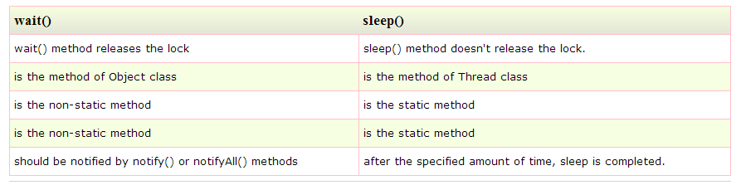
Inter-thread communication

Slide 15
What are we learning in Next Chapter ?
IO STREAMS & SERIALIZATION
File
Input Stream
Output Stream
Reader
Writer
Serialization
Deserialization

Slide 16
Thank You !

